Slide 1
Cortana Intelligence Suite
Workshop
Reston Azure Datafest
10/12/2018

Slide 2
Agenda
Topic | Duration (Min) | Time
Cortana Intelligence Suite Keynote & Overview of Labs | 15 | 9:30 AM - 9:45 AM
Exercise 1: Building a Machine Learning Model | 75 | 9:45 AM - 11:00 AM
Exercise 2: Develop Azure Data Factory Pipeline | 15 | 11:00 AM - 11:15 PM
Exercise 3: Develop Data Factory Pipeline for Data Movement | 15 | 11:15 PM - 11:30 PM
Exercise 4: Operationalize ML Scoring with Azure ML and Data Factory | 15 | 11:30 PM - 11:45 PM
Exercise 5: Summarize Data Using HDInsight Spark | 30 | 11:45 PM - 12:15 PM
Exercise 6: Visualizing in Power BI | 15 | 12:15 PM - 12:30 PM
Exercise 7: Deploy Intelligence Web App |  | Self
Exercise 8: Cleanup of Azure resources |  | Self

Slide 3
Overview
fully managed Big Data and Advanced Analytics suite to transform data into intelligent action.
It is a collection of technologies, all part of the Microsoft Azure cloud offering.

Slide 4



Overview
Information Management
Big Data Stores
Machine Learning and Analytics
Intelligence
Data Sources
People
Data Factory
Data Lake Store
Machine Learning
Cognitive Services
Data Catalog
SQL Data
Warehouse
Data Lake Analytics
Bot
Framework
Web
Apps
HDInsight
(Hadoop and Spark)
Apps
Mobile
Event Hubs
Cortana
Bots
Sensors
and devices
Stream Analytics
Dashboards & Visualizations
Automated
Systems
Power BI
Data
Data
Intelligence
Action

Slide 5
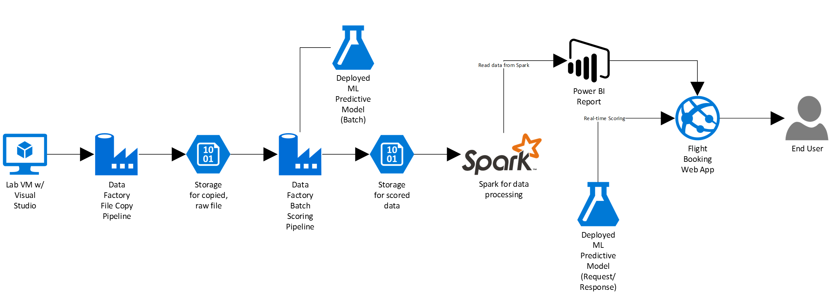
Labs
https://github.com/ggais/CortanaIntelligenceWorkshopPrereqDeployment
https://github.com/ggais/CortanaIntelligenceSuiteWorkshopManual

Slide 6
References
https://social.technet.microsoft.com/wiki/contents/articles/36688.introduction-to-cortana-intelligence-suite.aspx
https://mva.microsoft.com/en-us/training-courses/cortana-intelligence-suite-end-to-end-16972

